Slide 1
Maths: practical strategies for home learning PARENT WORKSHOP: Thursday 11th July 2019

Slide 2
Aims for this session
To share curriculum expectations
To understand the skills and expectations needed at KS2
To identify strategies that can support home learning in number
To explore how the Concrete, Practical, Abstract approach supports learning
To share the Bar Modelling approach for problem solving

Slide 3
Curriculum expectations
The national curriculum for mathematics aims to ensure that all pupils:
become fluent in mathematics
develop conceptual understanding and the ability to recall and apply knowledge rapidly and accurately
reason mathematically by following a line of enquiry, conjecturing relationships and generalisations, and developing an argument, justification or proof using mathematical language
can solve problems by applying their mathematics to a variety or routine and non-routine problems with increasing sophistication, including breaking down problems into a series of simpler steps and persevering in seeking solutions
Notes:
Fluency – use key words from the NC -–is more than chn being able to recall facts quickly but instead, it is about chn having a deep, flexible and adaptable understanding of Maths concepts. To promote fluency, Lessons and resources need to be crafted carefully to foster deep conceptual and procedural knowledge. .
If children are not fluent in basic facts, then when they are solving more complex problems, the working memory is taken up by calculating basic facts, and children have less working memory to focus on solving the actual problem So fluency in basic facts allows children to tackle more complex maths more effectively.
Children need to be taught strategies to solve number facts. most children don’t magically become fluent in these facts. If they aren’t explicitly taught to solve e.g. 6 + 7 by thinking ‘double 6 and one more’ or to solve 12 – 8 by using 'find the difference' strategies, then many children will get stuck on inefficient counting based approaches
Reasoning enables chn to make use of all their other mathematical skills when faced with a mathematical challenge. – discuss nrich – reasoning is systematic thinking
A conjecture is a mathematical statement that has not yet been rigorously proved. Conjectures arise when one notices a pattern that holds true for many cases.
Non routine problems are problems that are out of context where chn can apply their learning securely in a range of different contexts

Slide 4
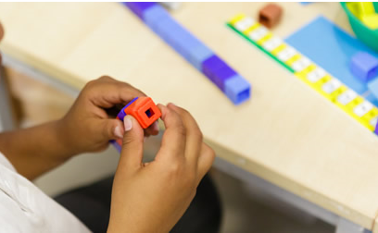
Skills in Maths and across the curriculum
Use Mathematical vocabulary
Explain ideas and evaluate outcomes
Make connections
Use fluency and recall
Predict and Justify
challenge ideas
Work systematically
Trial and improvement
Logical thinking
Be independent
Learn from mistakes
Collaborate with others
Spot patterns
Show resilience
Correct mistakes
Notes:
At grange park we would like all chn to develop these skills

Slide 5
Expectations by the end of Year 6
Notes:
When we say place value we really mean the value of a digit and what it represents eg knowing that in the number 21, it is made up of two tens and 1.

Slide 6
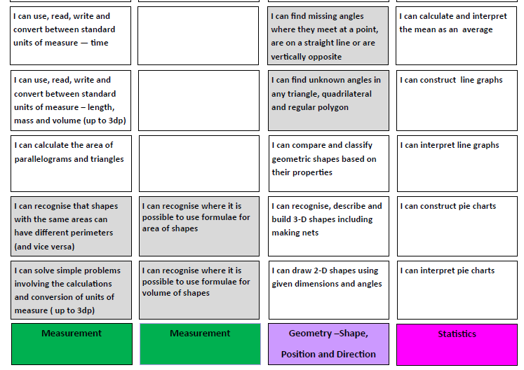

Slide 7
Expectations by the end of KS2
Notes:
Multiplication check for year 4 statutory from 2020 – we have subscribed to a website which is going to be rolled out to simulate the way in which these timed checks will be delivered – they are straightforward questions but there are lots of things that you can do to support chn with their learning of times tables

Slide 8
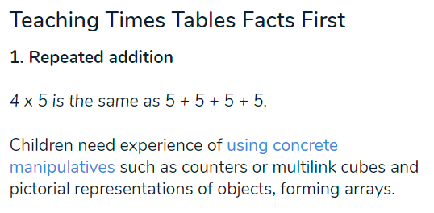
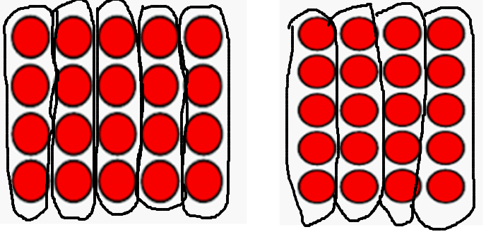
Strategies to support your child with timetables
What is the same?
What is different?
How many counters in each group in the first example?
How many counters in each group in the second example?
5 groups of 4
4 groups of 5
Notes:
If we can develop children’s working memory with greater reasoning and understanding, there will be an increased transition to their long term memory and times tables can become an instantly recallable fact.
All children need to go through these cognitive steps in order to achieve this. Some will only need a light touch whilst some will need significantly longer on particular points.
If chn are not fluent in understanding of time tables, when they are posed with a problem solving exercise, their working memory is taken up by how to do the calculation rather than focussing on how to approach and solve a problem. Teaching of time tables needs to be explicit so that it is not just chanting but so that they see the structure of what it looks like with resources they can touch like counters for example – this helps chn when posed with qs such as 5 x 12 , whats 5 x 13?

Slide 9
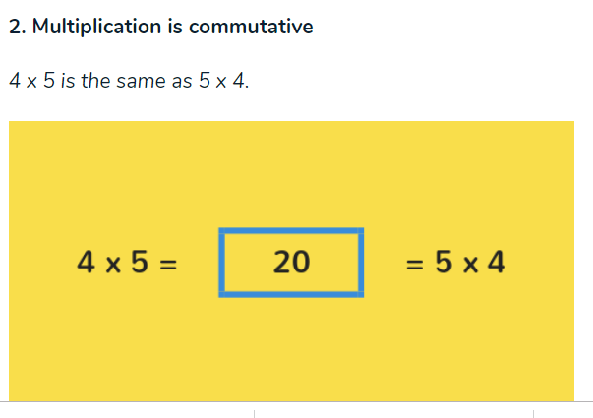
Strategies to support your child with timetables
Notes:
Commutative Only works for addition and multiplication

Slide 10
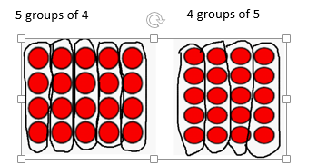
Children build on their existing understanding using arrays, turning the arrays around to show that you now have 5 groups of 4 and they will still total 20. This can then be linked to recalling multiplication facts, i.e. if they know their 5 times table as facts but not their 4 times table, they can use 4 x 5 to work out 5 x 4. This link needs to be made explicit.

Slide 11
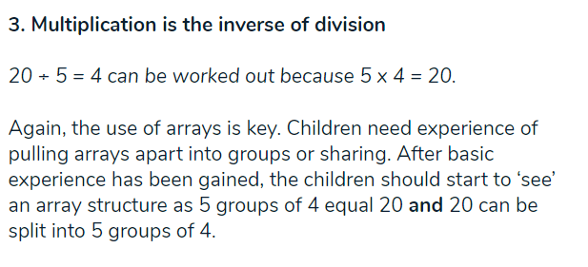
Notes:
Teaching multiplication alongside division is key as it helps children see the link between what we call number families

Slide 13
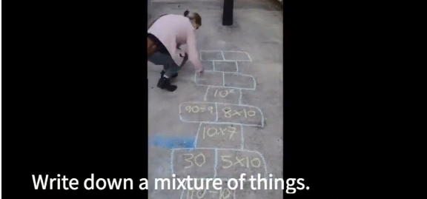
A few multiplications, divisions, products of the same times table.
The children shout out the answer as they hop along
Notes:
Reinforces long term memory

Slide 15
Knowing when to use efficient and appropriate strategies to calculate an answer
Use three post it notes and jot down the headings as above.
On other post it notes, write one calculation per post it note
Decide on your tables whether the most appropriate method would be mental, a quick jotting or formal written method.
Consider:
Why have you placed this calculation there?
Could you have used your knowledge of other facts to do it mentally? Or jottings?
Are there lots of different ways to solve the calculation?
Are some methods more efficient and appropriate than others? Why?
Can you explain why and how you placed the calculation in that pile?
Notes:
This is something we see chn struggle with

Slide 16
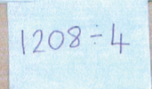
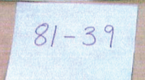
Why have you placed this calculation there?
Could you have used your knowledge of other facts to do it mentally? Or jottings?
Are there lots of different ways to solve the calculation?
Are some methods more efficient and appropriate than others? Why?
Can you explain why and how you placed the calculation in that pile?
Notes:
7505 divided by 5 = 1501 - you could divide it by 10 and then double it to divide by 5

Slide 17
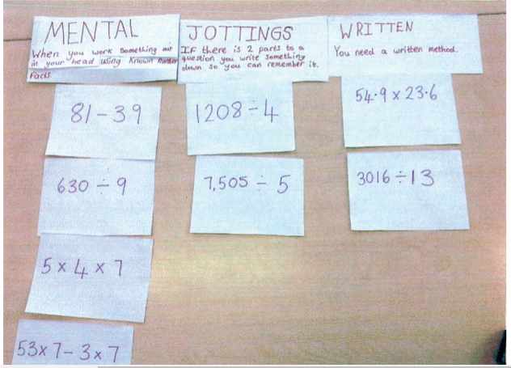

Slide 18
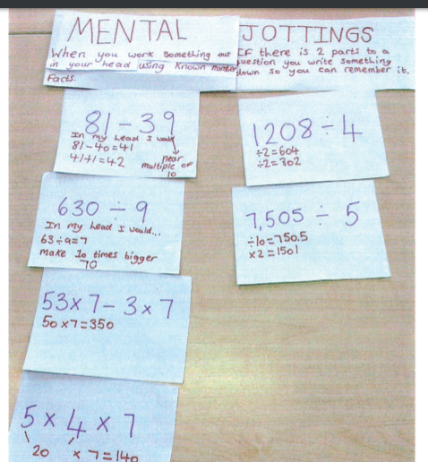

Slide 19
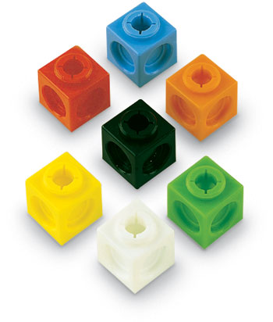
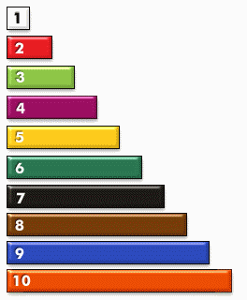
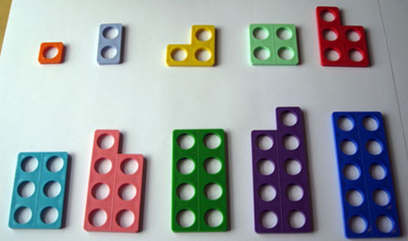
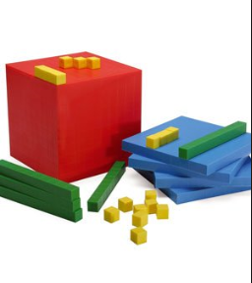
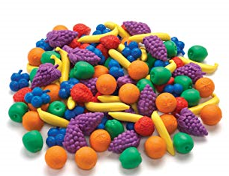
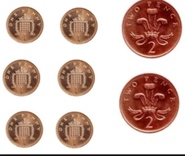
Manipulatives used in class to support understanding
Notes:
But every day objects are great – exposing chn to a range of different contexts and applying their learning

Slide 20
Notes:
Not the only aims of the curriculum but can be found by googling national curriculum primary maths – dfe website

Slide 21
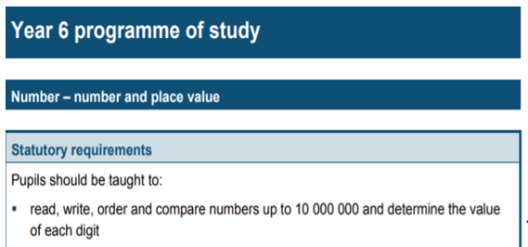
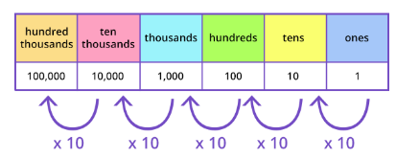
Using dienes , create an even number between 50 and 90 and add 10 or 100 or 1000 each time. Read the number, say the number and explain what each value of each digit is.
With place value counters, make record & say numbers of your choice… e.g.
1,250,000
1, 325, 200
One million, three hundred and twenty thousand and fifty four.
Notes:
Explain activity – rationale – some chn find even by year 6 that they have difficulty crossing the boundary over into 10s, 100s or 1000s so is a great activity for visually seeing
Do chn know that if they don’t have a thousand block, coulthey use 10 tens to get the same?
Do the chn know that we group numbers in threes, we spell a 100 with 2 zeros, 11 hundred is the same as 1 thousand 100 which links back to dienes activity or substitution. Partitioning the numbers knowing place value that as you move to the left, each column gets ten times bigger
with the pv counters you can see how partitioning the numbers support chns understanding of place value and how numbers are made up

Slide 22
Strategies to support home learning in Number
Ask your child to get a handful of 5p coins. Use to model structure of times tables, e.g. show 10 lots of 5p, what is 5 groups of 12p? 5p times 13 ?
http://www.bbc.co.uk/skillswise/topic/times-tables
Singing times tables songs with modern pop songs https://www.youtube.com/playlist?list=PLb7Q5jsm9eh_fdDPQmVpyp4XRu-raUbHc
Practising games can be accessed on these websites:
https://www.stem.org.uk/resources/elibrary/resource/29648/multiplication-and-division
http://www.primaryhomeworkhelp.co.uk/maths/timestable/interactive.htm
https://www.topmarks.co.uk/maths-games/7-11-years/multiplication-and-division

Slide 23
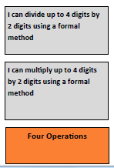
Expectations by the end of Year 6
Find the mistakes in the
calculation below. Correct it
and explain what you have
done.
4 6 2 9
x 1 2
1 0 8
2 4
7 2
3 6
2 0 4
Why do we ask children to place a 0 when calculating the second line?
Notes:
Do chn recognise that when they begin multiplying the second line, they are now multiplying tens?

Slide 24
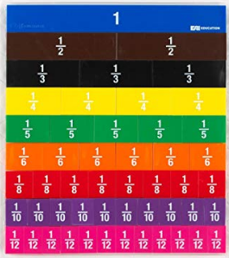
Strategies to support home learning in Number
Sam added together two fractions and got 3/6 as the answer. Write down two fractions that could have been added which are not sixths.
A teacher might show the children a fraction board or even a strip of paper for this exercise. How might you begin to approach this problem?
Consider:
Are there equivalences that could be used? How might you show this?

Slide 25
Strategies to support home learning in Number
Sam added together two fractions and got 3/6 as the answer. Write down two fractions that could have been added which are not sixths.
The teacher might then explain that as the answer doesn’t allow sixths to be used, what other equivalences are there? By folding the paper into 12ths or halves, children will see that perhaps a simple answer of 1/6 + 2/6 = 3/6 can become
5/12 + 1/12 = 6/12 = 3/6 = 1/2
Or a fraction board can easily show as a visual these equivalences in quarters for example

Slide 26
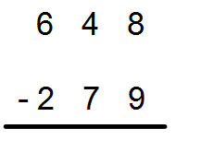
Key stage 2 subtraction – decomposition method
What sort of mathematical language would you use with your child to help them solve this calculation?
What might they need to understand in order to solve this subtraction?
How can we link knowledge of place value to make connections and help support deep understanding rather than procedural?

Slide 27
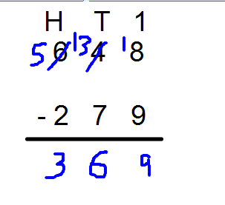
Key stage 2 subtraction – decomposition method
What sort of mathematical language would you use with your child to help them solve this calculation?
What might they need to understand in order to solve this subtraction?
How can we link knowledge of place value to make connections and help support deep understanding rather than procedural?
Does the child know that when they take 1 hundred from the hundreds column and bring it over to the tens column, they are actually still bringing over 1 hundred but because its in the tens column it is really broken down into ten tens which makes a hundred? This is because you can only have tens in the ten column. And actually you have 13 tens in the 13 column which is 130 – 7 tens which is 70? Giving you an answer of 6 in the tens column which is 60?
Notes:
Emphasise no borrowing – implies we give back – we don’t – we take
Emphasise the difference between chn just following the procedural and having deep understanding of the link with place value

Slide 28
Concrete, pictorial, abstract approach
Concrete
Actual objects to illustrate the problem
Generic concrete
Materials such as multilink & Cuisenaire, post it pads.
Pictorial representations
Individual squares, joined squares and then rectangular bars
Abstract
Written methods
Build it … Draw it… Write it…..Say it.
Notes:
Even in year 6 maniuplatives can and should be used

Slide 29
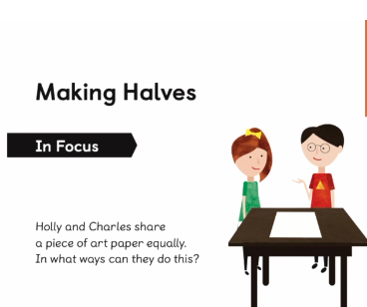
Concrete, pictorial, abstract approach
Have a go at using the post it notes (concrete) on the table to illustrate the problem
Now try to solve using the post its or any other pictorial representation if you wish to draw it
Can you find more than 3 ways?
Build it … Draw it… Write it…..Say it.
Notes:
Yr 3

Slide 30
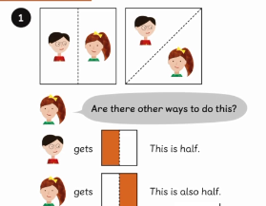
You may have started to fold you paper vertically and or horizontally/
diagonally.

Slide 31
Most of us considered splitting the post it note to make a half but did we consider halves in other ways?
The last example shows how the triangles can be put together to make a half

Slide 32
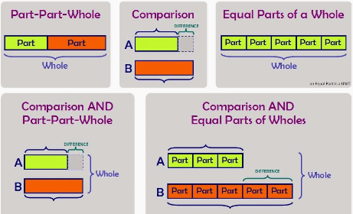
Bar modelling for problem solving as part of CPA approach
Notes:
Bar modelling is part of the concrete > pictorial > abstract (CPA) sequence when teaching certain maths topics. The process starts with using real-world, tangible representations before moving onto showing the problem using pictorial diagrams, and then introducing the abstract algorithms and notations (such as the +, -, x and / symbols).
The bars don’t need to be precisely measured, but they do need to be proportional, so children can see the difference between them and the numbers they represent.
Bar models don’t give you an answer – they give you an understanding of what to do in order to get to the answer. Children need to have strategies to add, subtract multiply and divide for them to use bar models.
Bar modelling is not a ‘quick fix’ tool and will only work if the pupil has a good understanding of key concepts. It’s also important that children set out the bars correctly. If pupils are messy with the bar model or use the wrong model for a problem, this can prevent them from seeing how to solve the problem.

Slide 33
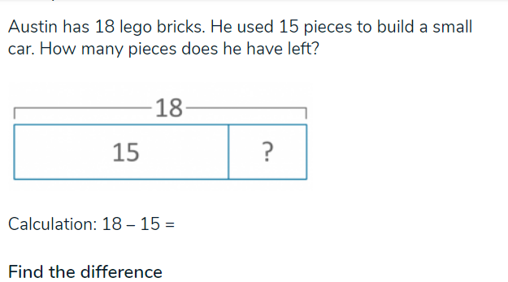
What is Bar modelling?
Bar models are pictorial representations of problems or concepts that can be used for any of the operations: addition, subtraction, multiplication and division. In word problems, bar models hold the huge benefit of helping children decide which operations to use or visualise problems.
Notes:
Bar models will not, however, do the calculations for the pupil. The bar modelling approach to Maths is much used in Singapore and Asian Maths textbooks and lessons and is a key maths mastery technique.

Slide 34
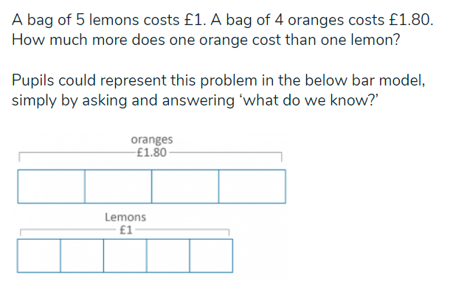
How can bar modelling support learning?

Slide 35
How can bar modelling support learning?

Slide 36
How can bar modelling support learning?

Slide 37
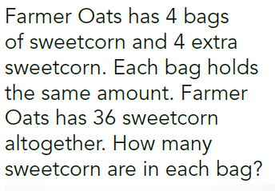
Example using bar model

Slide 39
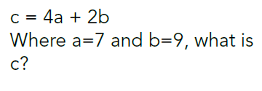
Multiplication and algebra
How could we use a bar model to represent this problem rather than use the abstract method of multiplication first eg
4 x a + 2 x b =

Slide 40
Multiplication and algebra

Slide 41
Bar modelling for problem solving as part of CPA approach
By the end of KS2 – a problem for children working at greater depth
Ben & Tom have some sweets
Tom has 5 times as many sweets as Ben
Tom gives 26 sweets to Ben.
They now have the same amount of sweets.
How many sweets were there altogether?
How many did they get each?
se the CPA method to solve.
Notes:
Importance of pulling out the language – what do we know?

Slide 42
Ben
Tom
There were ___ sweets altogether.
Ben and Tom have ___ sweets each.

Slide 43
26
Ben
13
13
?
Tom
13 x 6 =
There were 78 sweets altogether.
Ben and Tom have 39 sweets each.

Slide 44
Language of Maths
+, plus, add, how much more is…..?
- , subtract, minus, how much less is……?
Half, halve
=, equals, sign, tens, ones
Counting up
Number sentences
Digits
Double, halve, share, left over,
Near doubles
Count in 2s,5s and 10s
Groups of

Slide 45
ICT Games to support learning
www.ictgames.com/soccer_subtraction.html
www.ictgames.com/football2.html
www.ictgames.com/airlineGrouping/index.htm
www.ictgames.com/airlineGrouping/index.htm
www.ictgames.com/arrowCards_revised_v6.html

Slide 46
Thank you for coming

